Slide 1
NumaConnect
Technology
Steffen Persvold, Chief Architect
OPM Meeting, 11.-12. March 2015

Slide 2
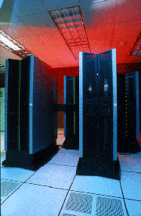
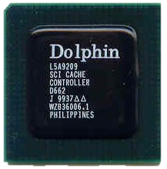
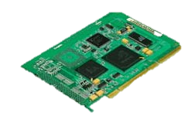
Technology Background
Convex Exemplar (Acquired by HP)
First implementation of the ccNUMA architecture from Dolphin in 1994
Data General Aviion (Acquired by EMC)
Designed in 1996, deliveries from 1997 - 2002
Dolphin chipset with 3 generations of Intel processor/memory buses
I/O Attached Products for Clustering OEMs
Sun Microsystems (SunCluster)
Siemens RM600 Server (IO Expansion)
Siemens Medical (3D CT)
Philips Medical (3D Ultra Sound)
Dassault/Thales Rafale
HPC Clusters (WulfKit w. Scali)
First Low Latency Cluster Interconnect
Convex Exemplar Supercomputer
Dolphin’s
Cache Chip
Dolphin’s Low
Latency Clustering HW

Slide 3
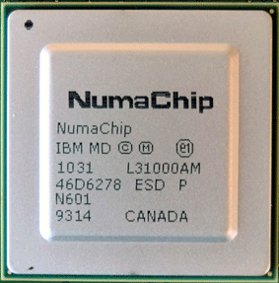
NumaChip-1
IBM Microelectronics ASIC
FCPBGA1023, 33mm x 33mm, 1mm ball pitch, 4-2-4 package
IBM cu-11 Technology
~ 2 million gates
Chip Size 9x11mm

Slide 4
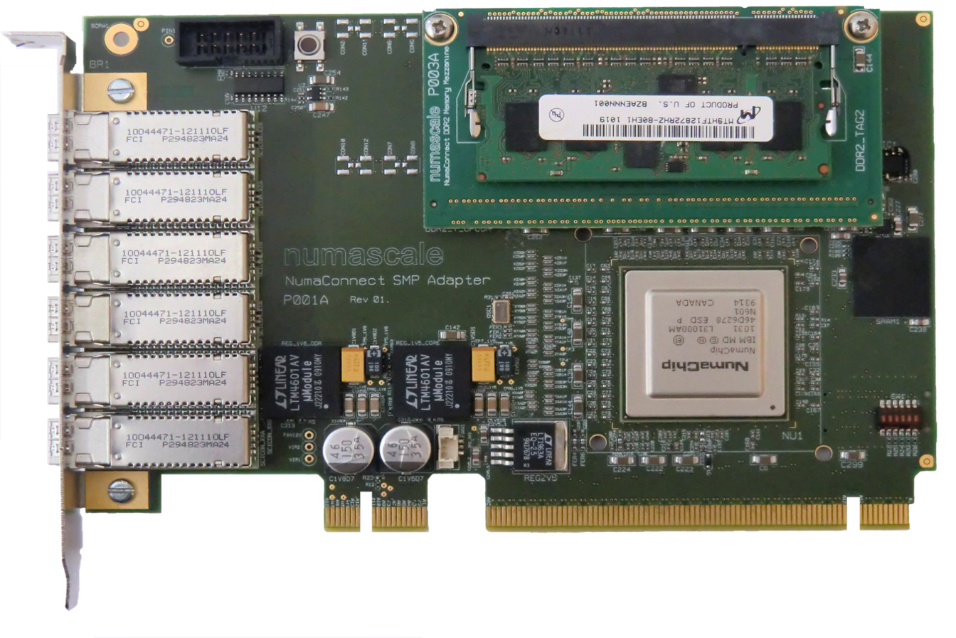
NumaConnect-1 Card

Slide 5
SMP - Symmetrical
SMP used to mean “Symmetrical Multi Processor”
Shared Memory
BUS
CPU
CPU
CPU
I/O

Slide 6
SMP – Symmetrical, but…
Caches complicate - Cache Coherency (CC) required
Shared Memory
BUS
Caches
Caches
Caches
Caches
CPUs
Caches
CPUs
Caches
CPUs
zzz
I/O

Slide 7
NUMA – Non Uniform Memory Access
Access to memory controlled by another CPU is slower - Memory Accesses are Non Uniform (NUMA)
Memory
Memory
Memory
Caches
Caches
Caches
Caches
CPUs
Caches
CPUs
Caches
CPUs
zzzzzz
I/O
Point-to-point Links

Slide 8
SMP - Shared MP - CC-NUMA
Non-Uniform Access Shared Memory with Cache Coherence
Memory
Memory
Memory
Foo
Caches
Caches
Caches
Caches
CPUs
Foo
Caches
CPUs
Caches
CPUs
Foo
zzzzzzzzz
I/O

Slide 9
SMP - Shared MP - CC-NUMA
Non-Uniform Access Shared Memory with Cache Coherence
Memory
Memory
Memory
Foo
Caches
Caches
Foo
Caches
Caches
CPUs
Foo
Caches
CPUs
Caches
CPUs
Foo
Foo
zzzzzzzzzzz
I/O

Slide 10
SMP - Shared MP - CC-NUMA
Non-Uniform Access Shared Memory with Cache Coherence
Memory
Memory
Memory
Foo
Caches
Caches
Caches
Caches
CPUs
Caches
CPUs
Caches
CPUs
Fool
Foo
Zzzzzzz
Zzzzzzz!
Fool
I/O

Slide 11
Numascale System Architecture
Shared Everything - One Single Operating System Image
Memory
Numa Cache
Memory
Numa Cache
Memory
Numa Cache
Memory
Numa Cache
Caches
CPUs
Caches
CPUs
Caches
CPUs
Caches
CPUs
Caches
Caches
Caches
Caches
NumaChip
NumaChip
NumaChip
NumaChip
I/O
I/O
I/O
I/O
NumaConnect Fabric - On-Chip Distributed Switching

Slide 12
NumaConnect™ Node Configuration
Memory
Memory
Memory
Memory
Memory
Memory
Memory
Memory
Multi-Core
CPU
Multi-Core
CPU
I/O Bridge
Coherent HyperTransport
NumaChip
Memory
Numa
Cache+Tags
6 x4 SERDES links

Slide 13
NumaConnect™ System Architecture
Multi-CPU Node
Memory
Multi-Core
CPU
Memory
Memory
2-D Torus
Memory
Numa
Cache
Memory
Memory
Multi-Core
CPU
Memory
Memory
NumaChip
Memory
3-D Torus
I/O Bridge
6 external links - flexible system configurations in multi-dimensional topologies

Slide 14
NumaChip-1 Block Diagram
HyperTransport
SM
SPI
SPI Init Module
ccHT Cave
SDRAM Cache
LC Config Data
H2S
Microcode
SDRAM Tags
CSR
SCC
Crossbar switch, LCs, SERDES
XA
XB
YA
YB
ZA
ZB

Slide 15
2-D Dataflow
Memory
Memory
Memory
Memory
CPUs
Caches
NumaChip
Memory
Memory
Memory
Memory
Memory
CPUs
Caches
Memory
Memory
NumaChip
Memory
CPUs
Caches
NumaChip
Request
Response

Slide 16
The Memory Hierarchy

Slide 17
LMbench - Chart
RemoteMemory
1087
NumaCache(L4)
308
CPU Caches
L3
L2
16,732
6,421
L1
1,251

Slide 18
Principal Operation – L1 Cache Hit
NumaCache
NumaCache
NumaChip
NumaChip
Memory
Memory
Mem. Ctrl.
HT Interface
To/From Other nodes
in the same dimension
HT Interface
Mem. Ctrl.
L3 Cache
L3 Cache
L1&L2 Caches
L1&L2 Caches
CPU Cores
CPU Cores
L1 Cache HIT

Slide 19
Principal Operation – L2 Cache Hit
NumaCache
NumaCache
NumaChip
NumaChip
Memory
Memory
Mem. Ctrl.
HT Interface
To/From Other nodes
in the same dimension
HT Interface
Mem. Ctrl.
L3 Cache
L3 Cache
L1&L2 Caches
L1&L2 Caches
CPU Cores
CPU Cores
L2 Cache HIT

Slide 20
Principal Operation – L3 Cache Hit
NumaCache
NumaCache
NumaChip
NumaChip
Memory
Memory
Mem. Ctrl.
HT Interface
To/From Other nodes
in the same dimension
HT Interface
Mem. Ctrl.
L3 Cache
L3 Cache
L1&L2 Caches
L1&L2 Caches
CPU Cores
CPU Cores
L3 Cache HIT

Slide 21
Principal Operation – Local Memory
NumaCache
NumaCache
NumaChip
NumaChip
Memory
Memory
Mem. Ctrl.
HT Interface
To/From Other nodes
in the same dimension
HT Interface
Mem. Ctrl.
L3 Cache
L3 Cache
L1&L2 Caches
L1&L2 Caches
CPU Cores
CPU Cores
Local Memory Access, HT Probe for Shared Data

Slide 22
Principal Operation – NumaCache Hit
NumaCache
NumaCache
NumaChip
NumaChip
Memory
Memory
Mem. Ctrl.
HT Interface
To/From Other nodes
in the same dimension
HT Interface
Mem. Ctrl.
L3 Cache
L3 Cache
L1&L2 Caches
L1&L2 Caches
CPU Cores
CPU Cores
Remote Memory Access, Remote Cache Hit

Slide 23
Principal Operation – Remote Memory
NumaCache
NumaCache
NumaChip
NumaChip
Memory
Memory
Mem. Ctrl.
HT Interface
To/From Other nodes
in the same dimension
HT Interface
Mem. Ctrl.
L3 Cache
L3 Cache
L1&L2 Caches
L1&L2 Caches
CPU Cores
CPU Cores
Remote Memory Access, Remote Cache Miss

Slide 24
NumaChip Features
Converts between snoop-based (broadcast) and directory based coherency protocols
Write-back to NumaCache
Coherent and Non-Coherent Memory Transactions
Distributed Coherent Memory Controller
Pipelined Memory Access (16 Outstanding Transactions)
NumaCache size up to 8GBytes/Node
Current boards support up to 4Gbytes NumaCache

Slide 25
Scale-up Capacity
Single System Image or Multiple Partitions
Limits
256 TeraBytes Physical Address Space
4096 Nodes
196 608 cores
Largest and Most Cost Effective Coherent Shared Memory
Cache Line (64Bytes) Coherency

Slide 26
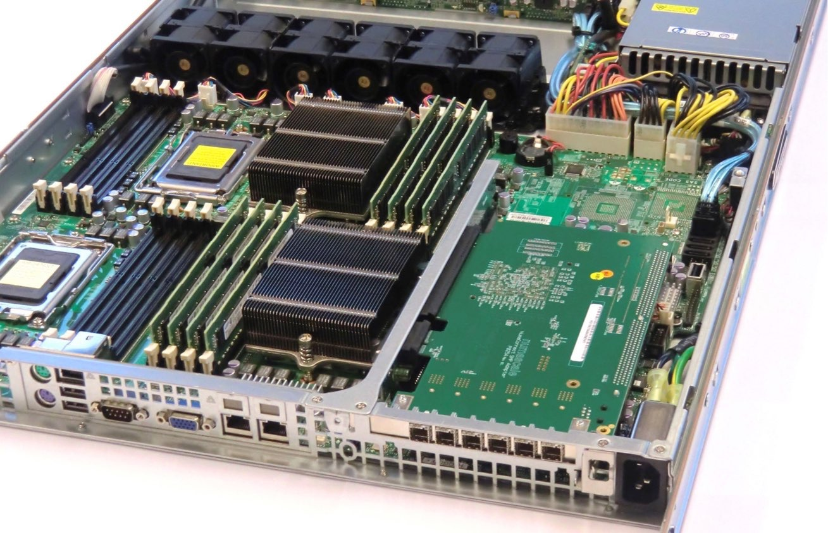
NumaConnect in Supermicro 1042

Slide 27
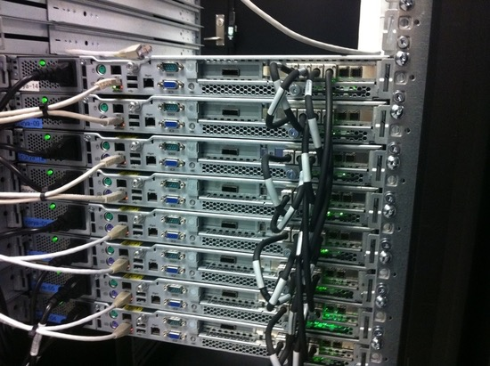
Cabling Example

Slide 28
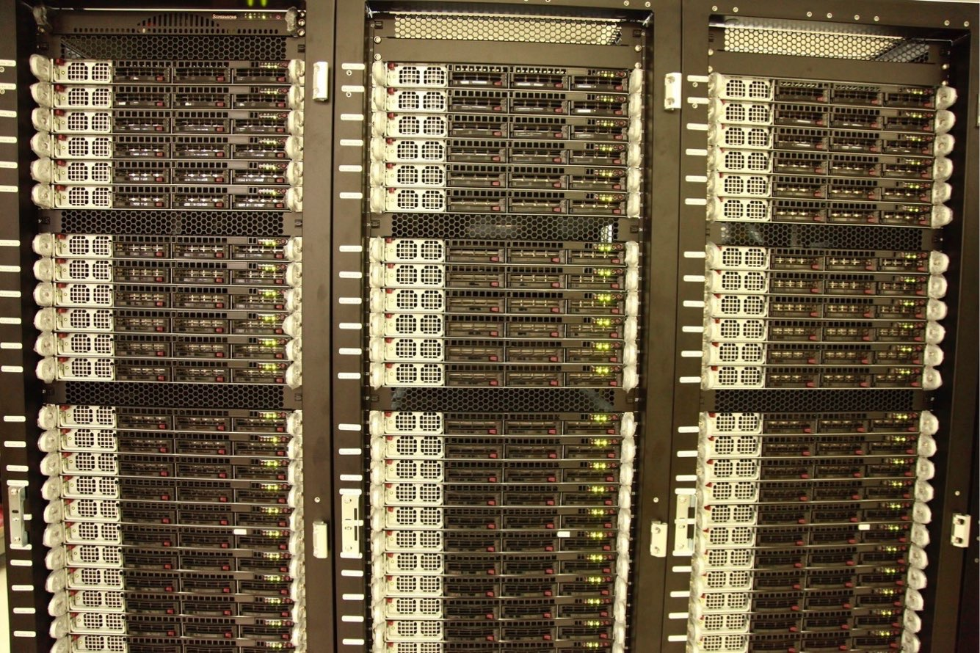
5 184 Cores – 20.7 TBytes
108 nodes
6 x 6 x 3 Torus
5 184 CPU cores
58 TFlops
20.7 TBytes Shared Memory
Single Image OS

Slide 29
OPM ”cpchop” scaling
Steffen Persvold, Chief Architect
OPM Meeting, 11.-12. March 2015

Slide 30
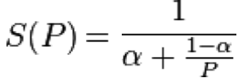
What is scaling ?
In High Performance Computing there are two common notions of scaling:
Strong scaling
How the solution time varies with the number of processors for a fixed total problem size.
\eta_p = t1 / ( N * tN ) * 100%
Weak scaling
How the solution time varies with the number of processors for a fixed problem size per processor.
\eta_p = ( t1 / tN ) * 100%

Slide 31
OPM – “cpchop” What was done ?
3 weeks to enable “cpchop” scalability
Initial state (Jan ‘14):
No scaling beyond 4 threads on a single server node
A few changes after code analysis enabled scalability
Removed #pragma omp critical sections from opm-porsol (needed fixes to dune-istl/dune-common) (Arne Morten)
Removed excessive verbose printouts (not so much for scaling but for “cleaner” multithreaded output).
Made sure thread context was allocated locally per thread.
Created local copies of the parsed input.
Dune::Timer class changed to use clock_gettime(CLOCK_MONOTONIC, &now) instead of std::clock() and getrusage() avoiding kernel spinlock calls
When building UMFPACK use –DNO_TIMING in the configuration or modify the code to use calls without spinlocks
Reduced excessive use of malloc/free by setting environment variables MALLOC_TRIM_THREASHOLD_=-1, MALLOC_MMAP_MAX_=0, MALLOC_TOP_PAD_=536870912 (500MB)

Slide 32
OPM – “cpchop” Making local object copies
diff --git a/examples/cpchop.cpp b/examples/cpchop.cpp
index 212ac53..da52c6a 100644
--- a/examples/cpchop.cpp
+++ b/examples/cpchop.cpp
@@ -617,7 +617,16 @@ try
#ifdef HAVE_OPENMP
threads = omp_get_max_threads();
#endif
- std::vector<ChopThreadContext> ctx(threads);
+ std::vector<ChopThreadContext*> ctx(threads);
+
+#pragma omp parallel for schedule(static)
+ for (int i=0;i<threads;++i) {
+ int thread = 0;
+#ifdef HAVE_OPENMP
+ thread = omp_get_thread_num();
+#endif
+ ctx[thread] = new ChopThreadContext();
+ }
// draw the random numbers up front to ensure consistency with or without threads
std::vector<int> ris(settings.subsamples);

Slide 33
OPM – “cpchop” Distribute input
@@ -638,6 +643,42 @@ try
rzs[j] = rz();
}
+#ifdef HAVE_HWLOC
+ Dune::Timer watch1;
+ Numa::Topology numatopology;
+
+ // Create a local copy of the CornerPointChopper object, one per numa board used
+ int boards = numatopology.num_boards();
+
+ std::vector<Opm::CornerPointChopper*> ch_local(boards);
+ std::atomic<bool> have_ch_local[boards];
+ for (int i=0;i<boards;++i) {
+ have_ch_local[i] = false;
+ }
+
+ // Assign the master instance into our pointer vector
+ {
+ int board = numatopology.get_current_board();
+ ch_local[board] = &ch;
+ have_ch_local[board] = true;
+ }

Slide 34
OPM – “cpchop” Distribute input cont’d
+
+ std::cout << "Distributing input to boards" << std::endl;
+ int distributed = 0;
+
+#pragma omp parallel for schedule(static) reduction(+:distributed)
+ for (int i = 0; i < threads; ++i) {
+ int board = numatopology.get_current_board();
+
+ if (!have_ch_local[board].exchange(true)) {
+ ch_local[board] = new Opm::CornerPointChopper(ch);
+ distributed++;
+ }
+ }
+
+ std::cout << "Distribution to " << distributed << " boards took " << watch1.elapsed() << " seconds" << std::endl;
+#endif // HAVE_HWLOC
+
double init_elapsed = watch.elapsed();
watch.reset();

Slide 35
OPM – “cpchop” scaling

