Slide 1
ResInsight Opm Meeting 11.03.2015
Jacob Støren
Ceetron Solutions AS

Slide 2
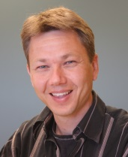
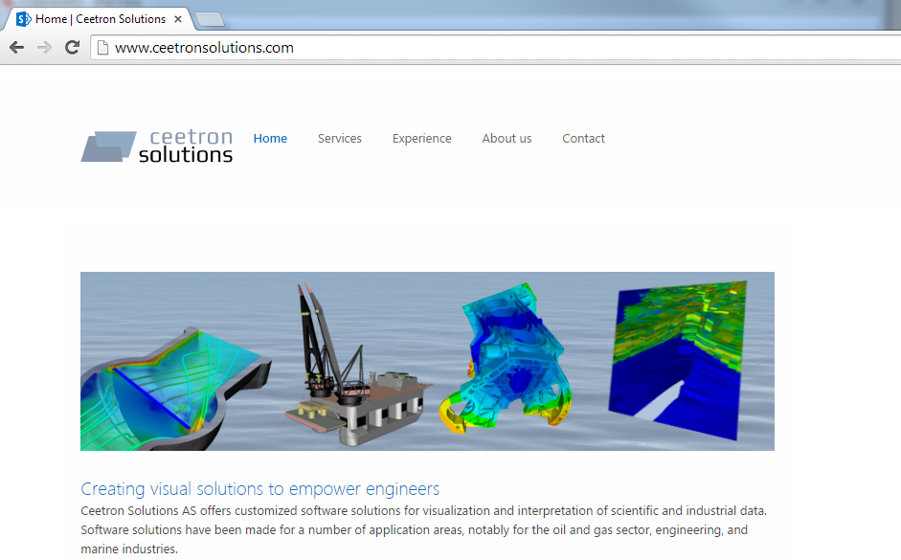
Presentation
Main developers of ResInsight
Magne Sjaastad
(Ceetron Solutions AS)
Jacob Støren
(Ceetron Solutions AS)
Ceetron Solutions AS
Founded in 2013
Spin-off from Ceetron AS
Employee-owned
Scientific visualization
Creating visual solutions to empower engineers
www.ceetronsolutions.com

Slide 3
Agenda
Overview of ResInsight
Tailored Visualization modes
Project History
Demo
Architecture and dependecies
ResInsigth on the web
Q an A

Slide 4
Overview
3D visualization of reservoir models and simulations
Supports ECLIPSE grids and simulation results
Powerful and flexible result manipulation
Octave based computation of derived properties
Open source license model
GPL v.3
Cross platform (Linux, Windows and OS-X (Thanks to Roland Kaufmann))
High performance
Instant startup
Handles large models (> 10 mill cells)
Tailored (and some unique?) visualization modes

Slide 5
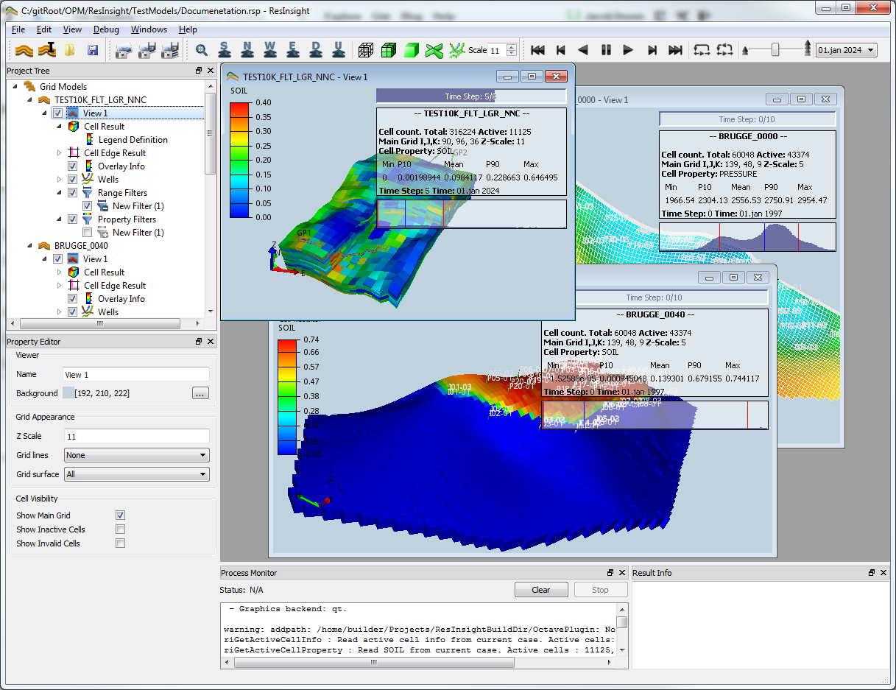
User interface

Slide 6
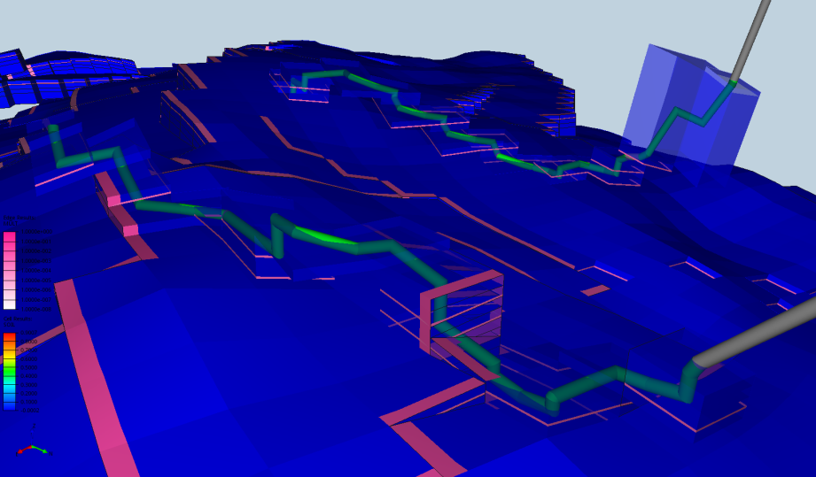
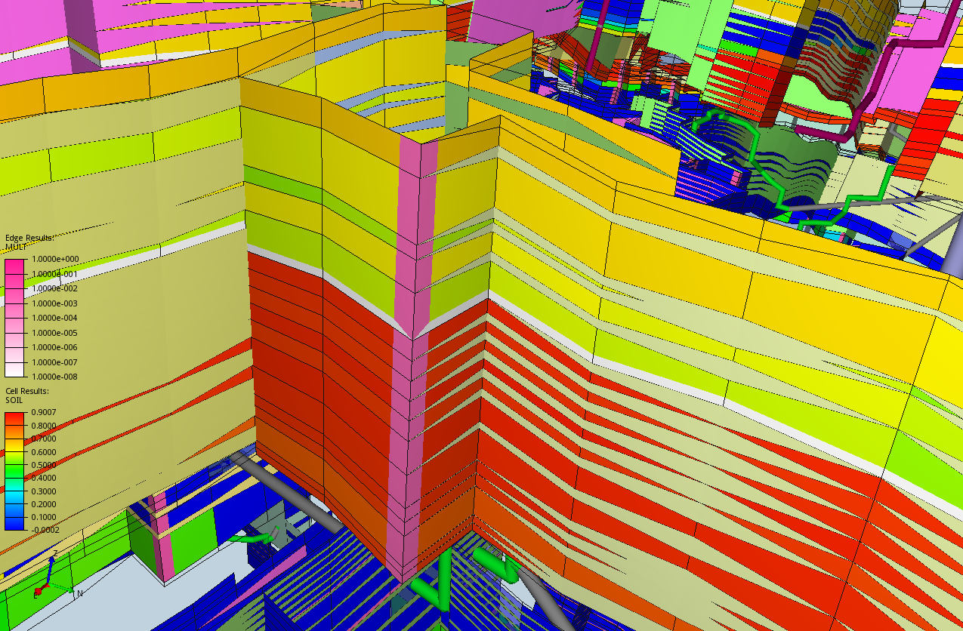
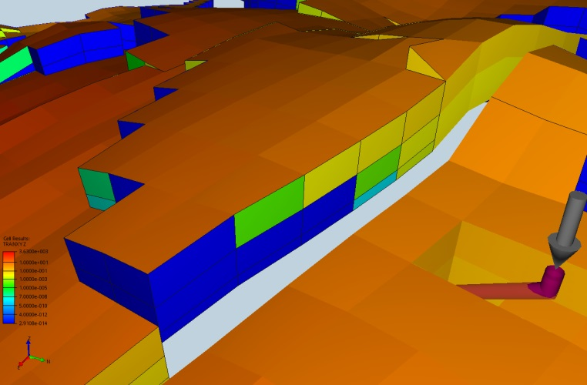
Tailored Visualization modes
Cell Edge
Wells
Combined XYZ properties
NNC Visualization

Slide 7
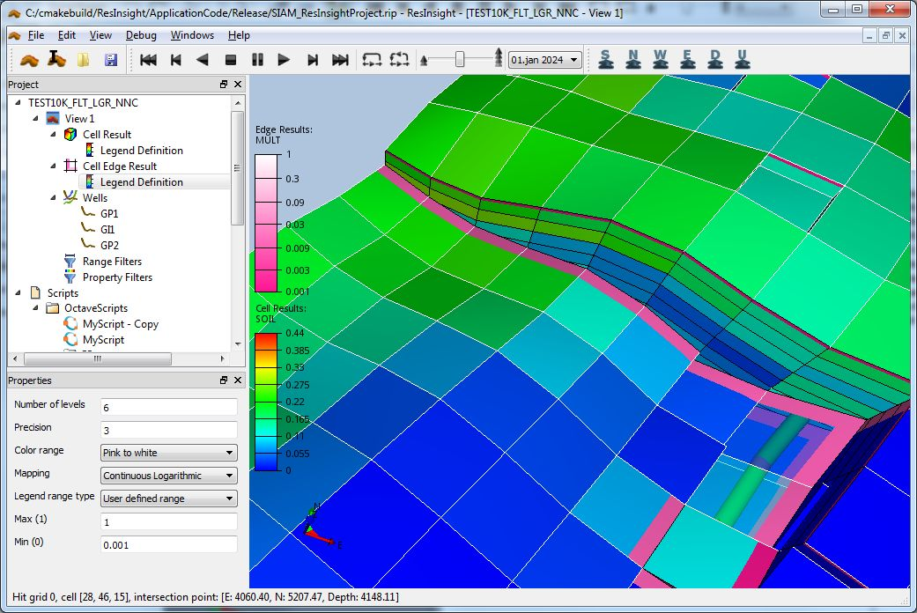
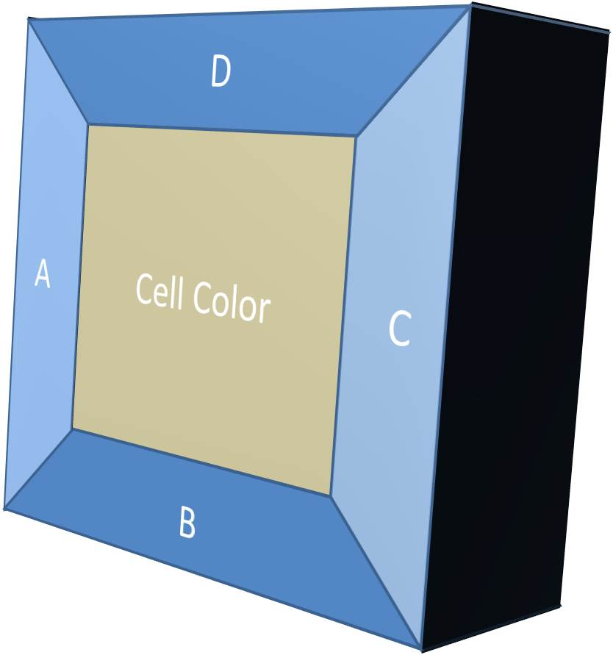
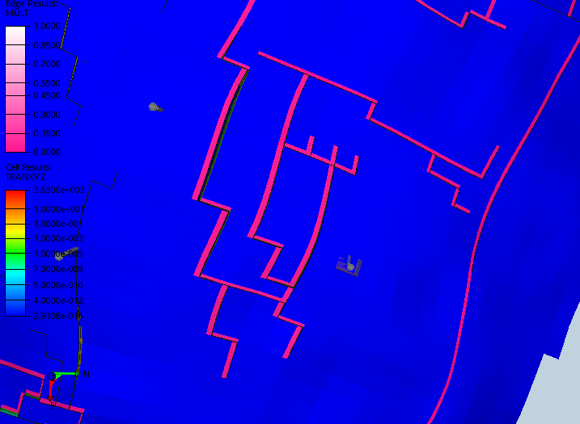
Cell edge visualization
Main property is color mapped to center area
Properties describing characteristics towards adjacent cells are visualized along the edges
Used for outlining MULT values
To show combined XYZ values

Slide 8
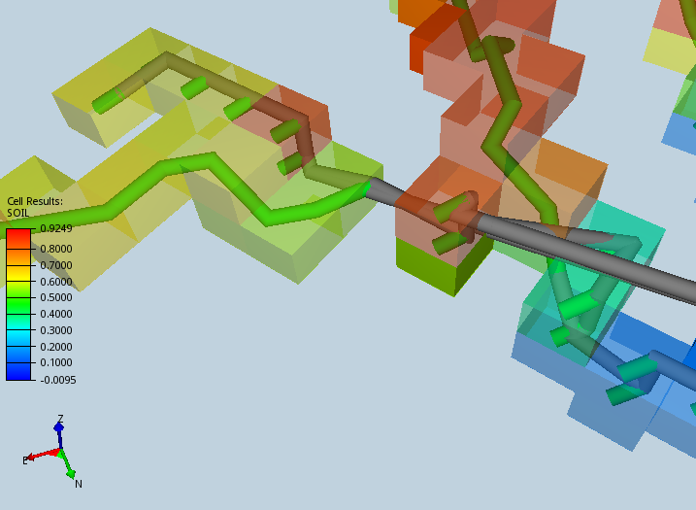
Well visualization
Smoothened well pipes with color status
Transparent Well cells
Advanced multi segment wells

Slide 9
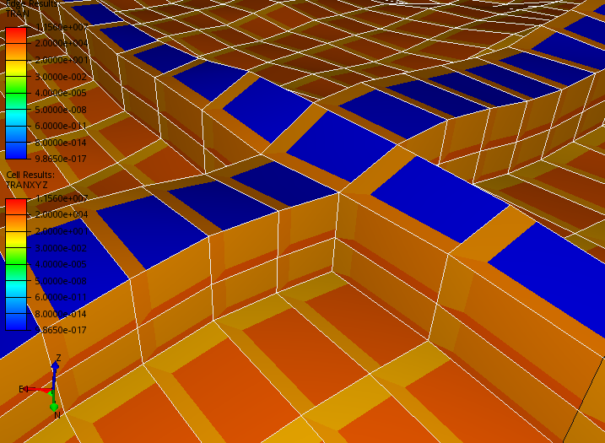
Combined XYZ properties
Show XYZ values on the «correct» Cell face
TRANXYZ, MULTXYZ
Derived QA properties: riTRANXYZbyArea
Can be combined with Cell-Edge

Slide 10
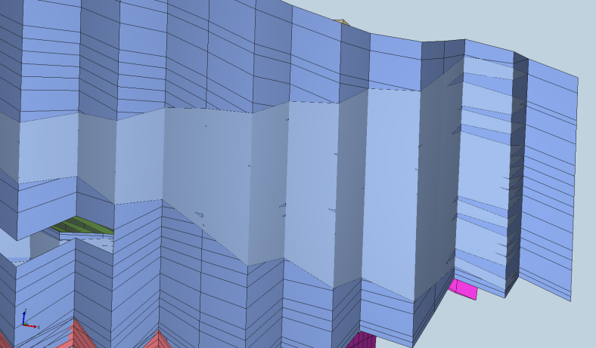
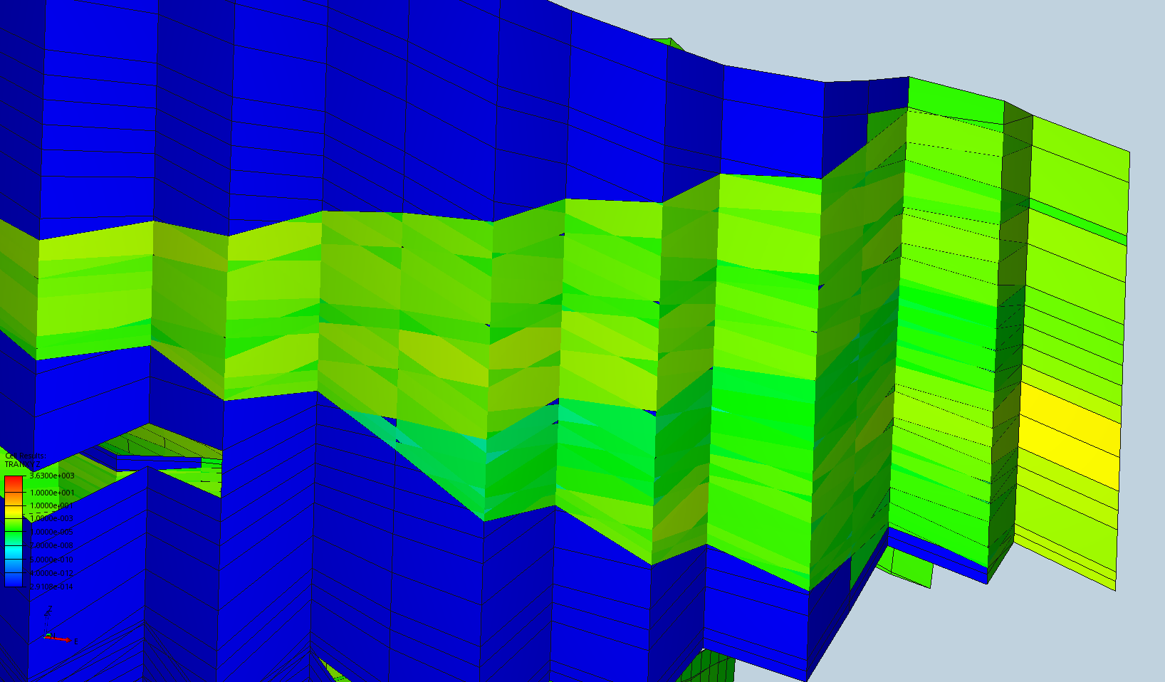
NNC visualization
Geometry
Colors
Transmissibility
Derived QA property riTRANbyArea

Slide 11
Project history
2011
Statoil R&D at Rotvoll (Trondheim) initiated the project
Hired Ceetron AS with a GPL version of their visualization framework
First test versions delivered on RHEL5
Focus on handling of large datasets (4-5 mill cells)
2012
Octave interface, Filtering of cells, Simulation wells
ResInsight was presented at SPE conference in Istanbul
Published on GitHub
2013
Well trajectories from text file and ssihub (Internal Statoil web service)
Multi-realization-statistics and batch functionality
Ceetron AS -> Ceetron Solutions AS continued the development
2014
NNC support
Customizations for Snorre
TDI process for qualifying ResInsight in Statoil

Slide 12
2015 – What now ?
Expecting to raise funding for basic maintenance
Several promising projects in the pipeline
Nothing decided yet

Slide 13
DEmo

Slide 14
Overall Architecture
ResInsight
Visualization Framework
Application Framework
Qt
OpenGL
ECLIPSE Reader
(ERT)
Socket
Octave

Slide 15
Libraries
VizFwk
Core 3D visualization library.
Developed by Ceetron/ Ceetron Solutions
GPL/LGPL
AppFwk
Field based project data model (PDM)
Automated user interface and XML serialization
Used for the user input data.
GPL/LGPL
ERT
Ensamble Based Reservoir Tool
ert.nr.no
GPL

Slide 16
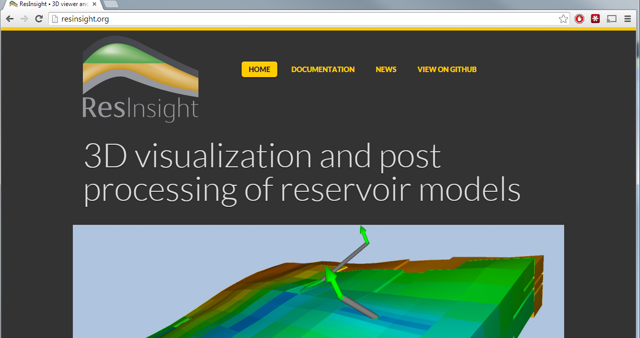
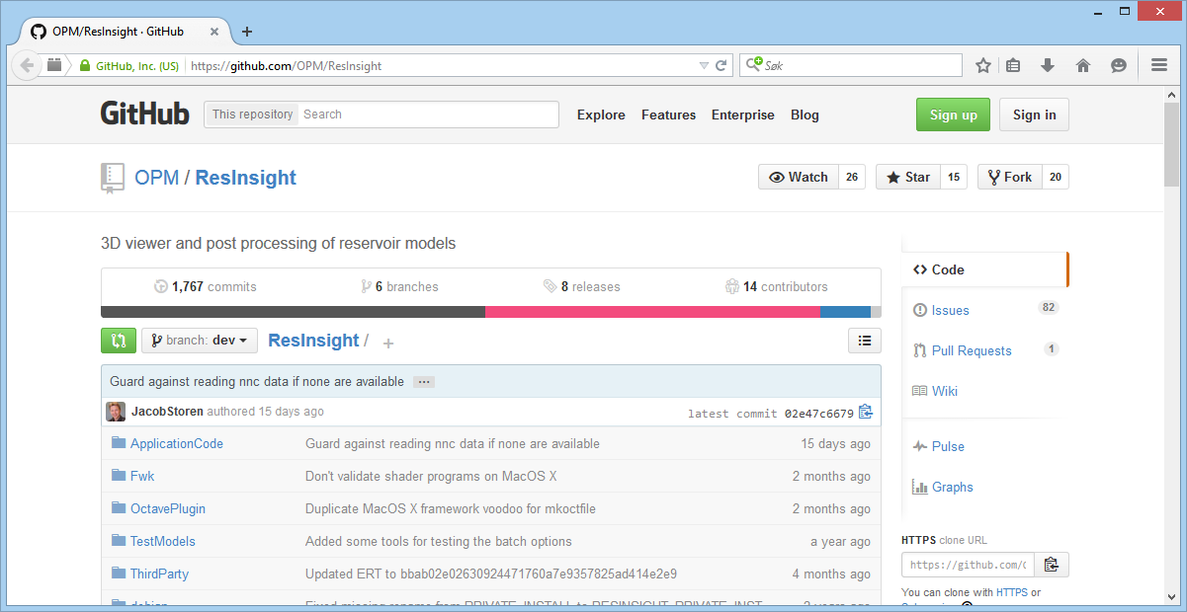
ResInsight on the web
http://resInsight.org
https://github.com/OPM/ResInsight

