Slide 1
ResInsight: Recent and future development Opm Meeting 03.06.2016
Jacob Støren
Ceetron Solutions AS

Slide 2
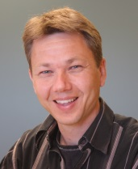
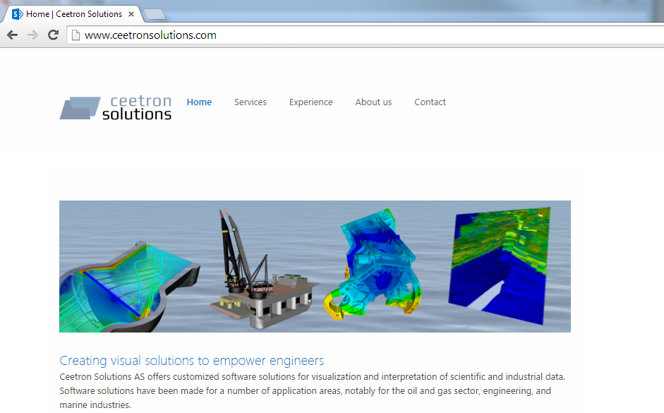
Presentation
Main developers of ResInsight
Magne Sjaastad
(Ceetron Solutions AS)
Jacob Støren
(Ceetron Solutions AS)
Ceetron Solutions AS
Founded in 2013
Spin-off from Ceetron AS
Employee-owned
Scientific visualization
Creating visual solutions to empower engineers
www.ceetronsolutions.com

Slide 3
Agenda
New Main Features
Since last OPM-meeting
ResInsight 1.4.0 – 1.6.0
With demonstration
Short history
Current projects and plans
What will the future bring ?

Slide 4
New Main Features

Slide 5
New Features (1)
Geomechanics
Supports ABAQUS odb-files produced by STATOIL
Conventions
HEX8 elements only
Timestep layout
Using Simulia ODB-Api (closed source)
Derived and tailored result values
Stress Path, Total Stress, Total Principal Stress
Geomechanical sign and unit
Similar functionality to Eclipse Cases
Range Filters
Property Filters
Well Paths
…

Slide 6
New Features (2)
Linked Views
Syncronize selected view properties across views
Navigation
Timestep
Result property
Range Filters
Property Filters
Works also between Geomechanical and Eclipse views
Can link several views with one master

Slide 7
New Features (3)
Comparable Well Log Plotting
Extract well log curves directly from grid results
Import, export and view LAS-files
Compare real Well Logs with simulation results
Intersections
Horizontals and Verticals
Along
Well paths
Simulation wells
User defined polyline

Slide 8
New Features (4)
UTM coordinate Grid Box
Time-history plot for selected cells
Improved statistics features in the Info Box
Shadows off
…

Slide 9
Short History

Slide 10
Project history
2011
Statoil R&D at Rotvoll (Trondheim) initiated the project
Hired Ceetron AS with a GPL version of their visualization framework
First test versions delivered on RHEL5
Focus on handling of large datasets (4-5 mill cells)
2012
Octave interface, Filtering of cells, Simulation wells
ResInsight was presented at SPE conference in Istanbul
Published on GitHub
2013
Well trajectories from text file and ssihub (Internal Statoil web service)
Multi-realization-statistics and batch functionality
Ceetron AS -> Ceetron Solutions AS continued the development

Slide 11
Project History
2014
NNC support
Customizations for Snorre
TDI process for qualifying ResInsight in Statoil
2015
ResInsight for Geo-mechanics
Abaqus analysis files
Intersections
Well log curves and extraction
Linked Views
Investigations for further development
2016
ResInsight for Flow-Diagnostics
Maintenance Agreement with Statoil

Slide 12
CURRENT PROJECTS AND PLANS

Slide 13
Current Projects
Maintenance Agreement with Statoil 2016
Ensures project independent maintenance
Tasks directly prioritized by Statoil
Flow Diagnostics for ResInsight
Cooperation With SINTEF
Ends 01.04.2017

Slide 14
Current Plans
Summary Plotting
Goals:
Efficient GUI to generate collections of curves
Stand alone mode
Exploit the presence of the 3D-data
Use OPM-Parser
Eventually enhance Eclipse Input file support

Slide 15
Current Plans
Flow Diagnostics
Functionality similar to MRST
Utilize a fast Time-of-Flight/Stationary tracer (TOF-ST) solver from SINTEF
3D Visualization
Time of Flight
Drainage and flooding regions
Well pair connections
2D Plotting
Stacked Bar plots, Pie Charts
Well allocation factors
TOF distance

Slide 16
What will the future bring?

Slide 17
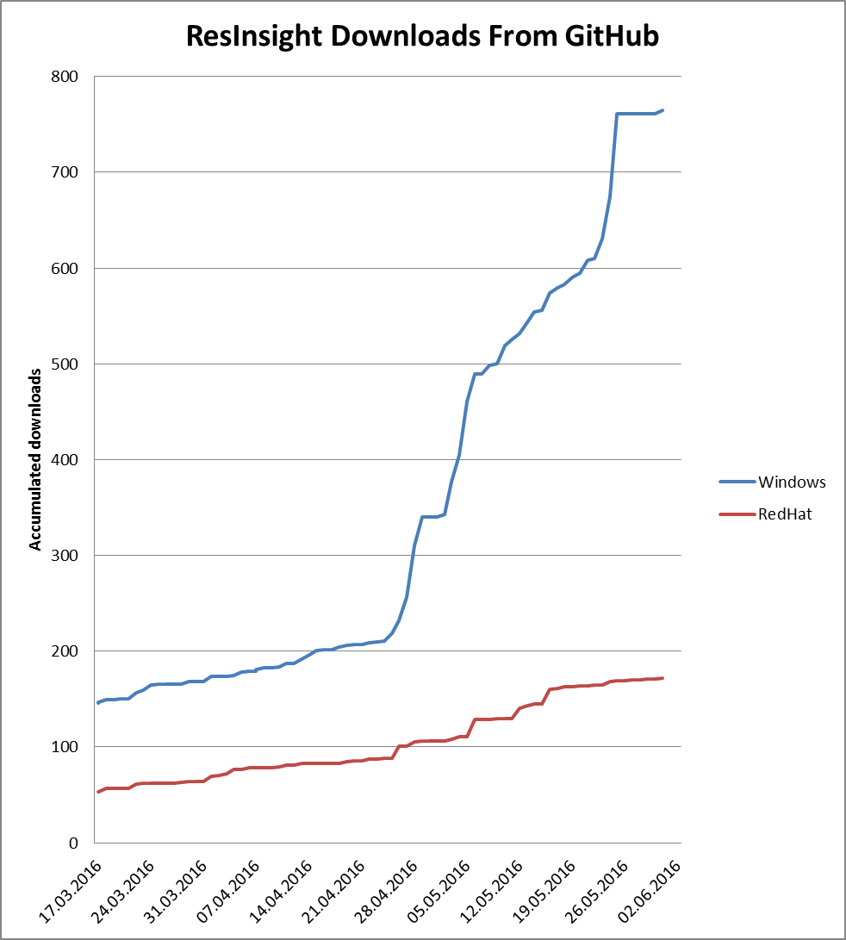
Downloads from GitHub
What started late April ?
Reasons unknown
What will the future bring ?

Slide 18
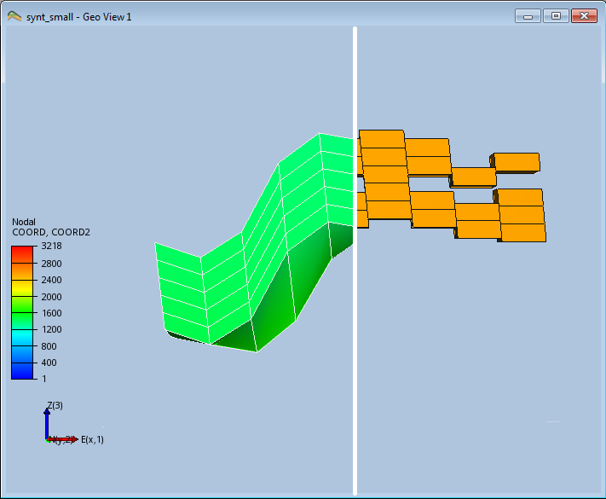
Future Plans
Report delivered to Statoil Jan 2016
ResInsight for Geomechanics
Describes possible new features
Import and Visualization of Seismic data
Well path editing
With dynamic update of extracted well log curves
Cross disciplinary co-visualization
Co-visualization of seismic, Geomechanic, and Eclipse grids.
Other discussed features
Extended Octave Support
Abaqus data
TOF-ST solver results
Tons on GitHub ☺
Divider plane with Abaqus grid to the left and
Eclipse grid to the right

