Slide 1
ML Based Newton preconditioner
Antoine Lechevallier
Supervised by:
Frédéric Nataf¹
Thibault Faney²
Sylvain Desroziers³
Eric Flauraud²
¹ Laboratoire Jacques-Louis Lions
² IFP Energies nouvelles
³ Michelin

Slide 2
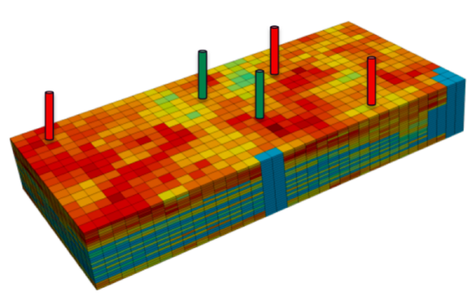
Numerical simulation of Carbon storage
Advantages | Drawbacks
Safety | Model uncertainties
Parametric studies | Parameters uncertainties
Cost and time efficiency | Computational resources
CO₂ storage requires important amount of simulations
→ Modify parameters to test scenarios
Explore recent breakthroughs in Artificial Intelligence to accelerate numerical simulation
2) Bicheng Yan et al.

Slide 3
Outline
Mathematical model and numerical resolution
Global Hybrid Newton
Results
Conclusion

Slide 4
Mathematical model and Numerical resolution

Slide 5
Mathematical model
Incompressible two-phase flow in porous medium
Mass conservation
Darcy’s law
Closure law

Slide 6
Numerical Resolution
P, S as main unknowns
S_{w} = 1 – S auxiliary unknown
Discretization
Finite volume in space
Implicit Euler in time
1
2

Slide 7
Numerical Resolution
P, S as main unknowns
S_{w} = 1 – S auxiliary unknown
Discretization
Finite volume in space
Implicit Euler in time
1
2
Fully Implicit scheme
Non-linear system of equations solved using Newton’s method
Unconditionnaly stable but large time steps can prevent Newton’s method from converging

Slide 8
Numerical Resolution
P, S as main unknowns
S_{w} = 1 – S auxiliary unknown
Discretization
Finite volume in space
Implicit Euler in time
1
2
Python library:
Yads: Yet Another Darcy Solver
Fully Implicit scheme
Non-linear system of equations solved using Newton’s method
Unconditionnaly stable but large time steps can prevent Newton’s method from converging

Slide 9
Reservoir geometries
1D | 200 cells
 | Variable parameters :
 |  | Well injection flow rate: q_{g}
 |  | Time-step: dt
q_{g}
11 MPa
10 MPa
0
5 000
10 000

Slide 10
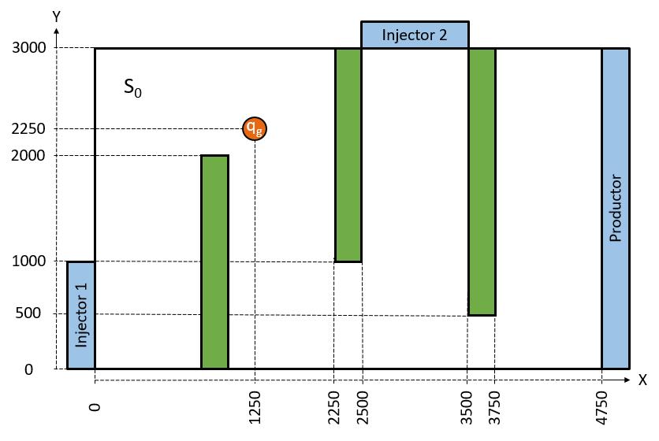
Reservoir geometries
1D | 200 cells
 | Variable parameters :
 |  | Well injection flow rate: q_{g}
 |  | Time-step: dt
q_{g}
11 MPa
10 MPa
0
5 000
10 000
 | SHPCO2 benchmark¹
2D | 95 X 60 cells
 | Variable parameters :
 |  | Initial saturation: S₀
 |  | Well injection flow rate: q_{g}
 |  | Time-step: dt
1) Florian Haeberlein 2011 Time Space Domain Decomposition Methods for Reactive Transport — Application to CO2 Geological Storage.

Slide 11
Global Hybrid Newton

Slide 12
Global Hybrid Newton
Scenario :
Well opening
Well closing
Transport
1
2

Slide 13
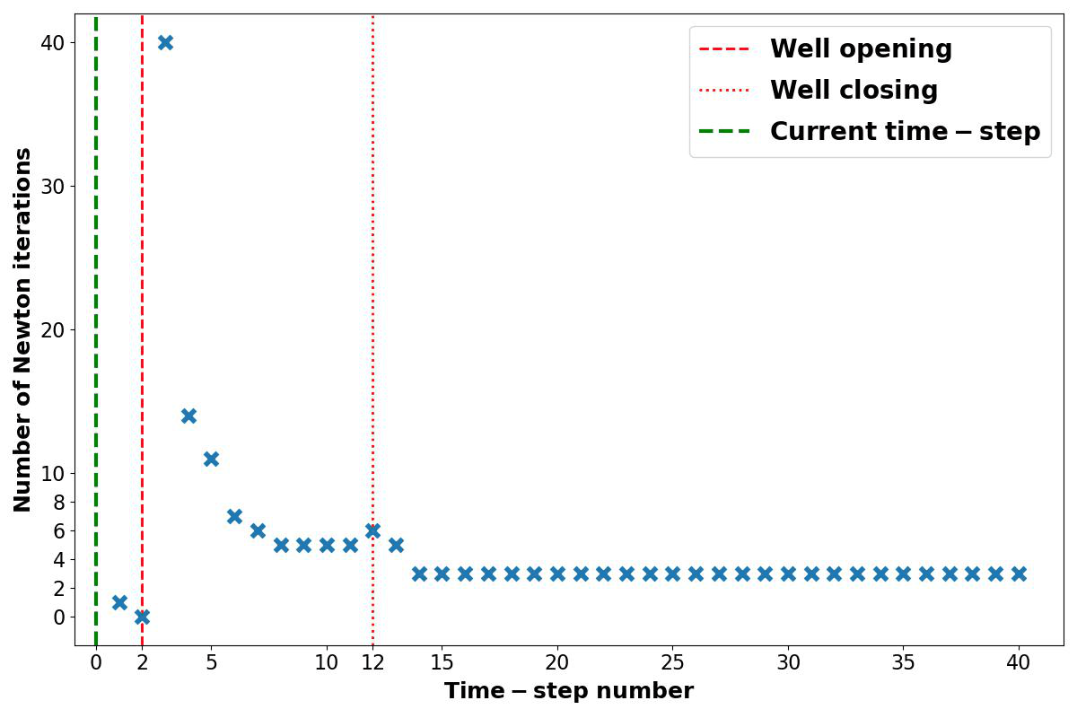
Global Hybrid Newton
Scenario :
Well opening
Well closing
Transport
Computational cost?
1
2
1
2

Slide 14
Global Hybrid Newton
Scenario :
Well opening
Well closing
Transport
Computational cost?
Well opening requires 40 Newton iterations
1
2
1
2

Slide 15
Hybrid initialization: 1D example

Slide 16
Hybrid initialization: 1D example
Pressure | Implicit Pressure Solver
 | → Solve linear system

Slide 17
Hybrid initialization: 1D example
Pressure | Implicit Pressure Solver
 | → Solve linear system
Saturation | Well events are similar in space and time
 | → Machine Learning model

Slide 18
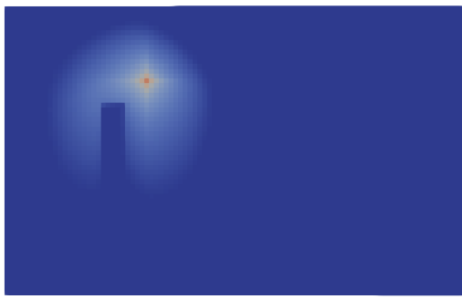
Workflow
Generate data
Supervised training of Saturation model
Plug saturation model in Newton’s method
Cover large range of well events
Fourier Neural operator
S_{guess} = f_{θ}(P_{imp},S, q_{g},dt)
Compare Hybrid with Standard Newton’s method

Slide 19
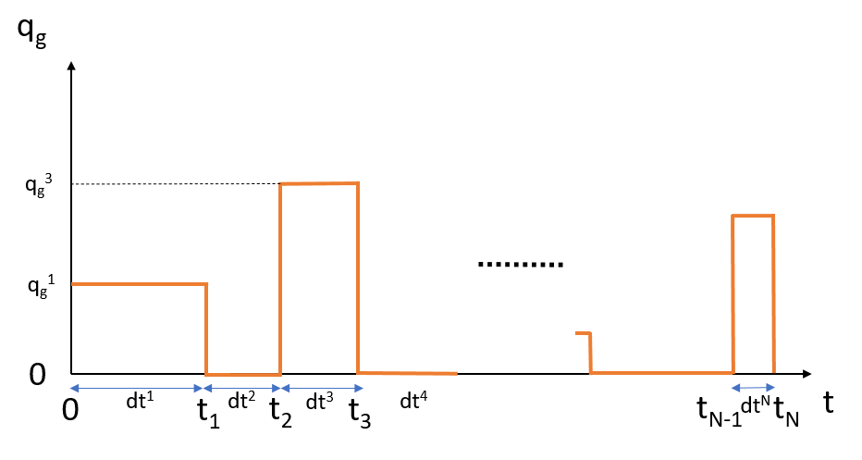
Data Generation
Variable parameters
Well injection flow rate: q_{g} Є [10⁻⁵, 10⁻³] m²/s
Well opening time: dt Є [1, 10] years
Reservoir gas saturation: S Є [0, 0.6]
Generate realistic saturations S
Consecutive well opening and closing
3 600 parameters combination
18 000 samples
Computational cost
Run in parallel using MPI
360 CPUs
≈36 hours

Slide 20
Fourier Neural Operator¹
Input function
Output function
Lifting
Projection
Pressure
Saturation
Inference:
Majority of the inference cost is in the Fourier Transform !
Fast Fourier Transform → Nlog(N)
1) Zongyi Li, et al 2020. Fourier neural operator for parametric partial differential equations.

Slide 21
Saturation model - Architecture
Input features
Output feature
Saturation
Saturation
Implicit pressure
q_{g}
dt
Saturation

Slide 22
Saturation model - Training
Dataset
80% train / 20% test
Computational cost
132 hours on NVIDIA V100 GPU
Hyperparameters
Loss: $\frac{1}{N}\sum_{i=1}^{N}{\frac{{\left\|s_{i}−{\hat{s}}_{i}\right\|}_{2}}{{\left\|s_{i}\right\|}_{2}}}$
Batch size: 128
Adam optimizer
Starting learning rate: 10⁻⁴
Momentum: 0.9
Weight decay: 10⁻⁴
Best model | epoch 7295
Test loss | 8.7 x 10⁻⁴
Train loss | 9.3 x 10⁻⁴

Slide 23
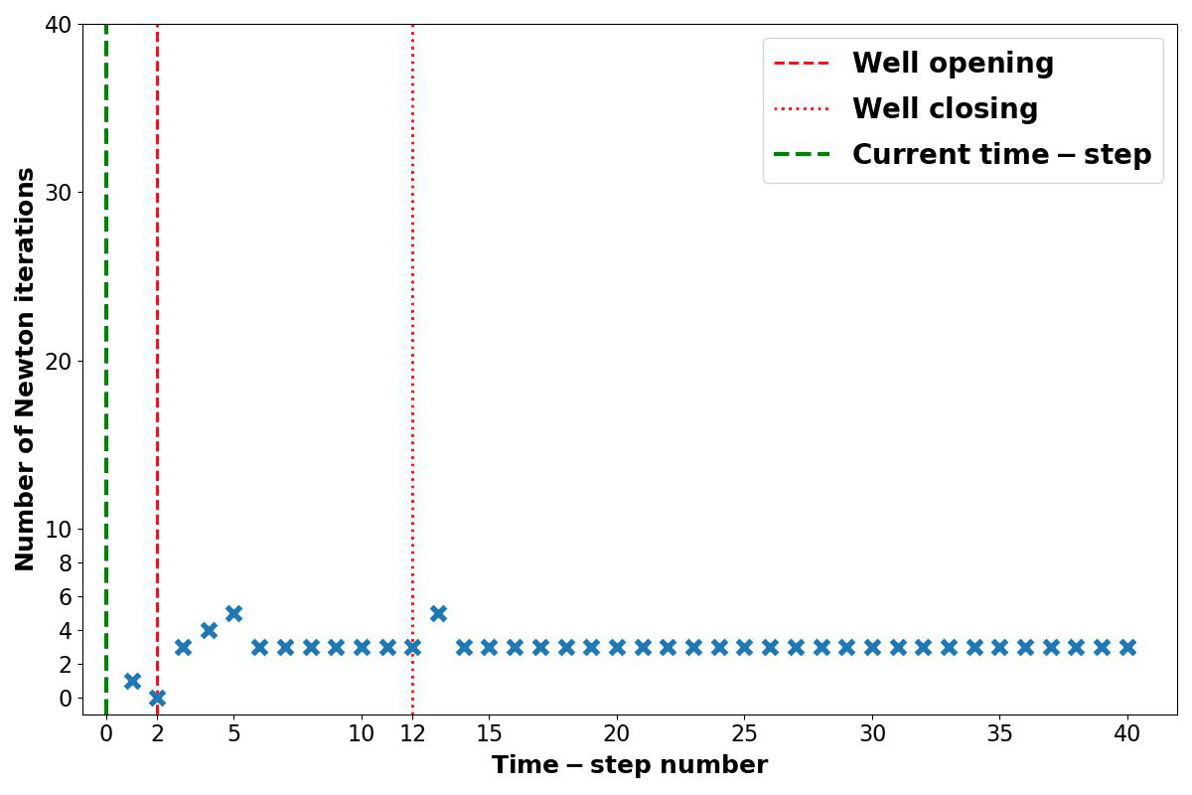
Results
Hybrid Newton
Standard Newton

Slide 24
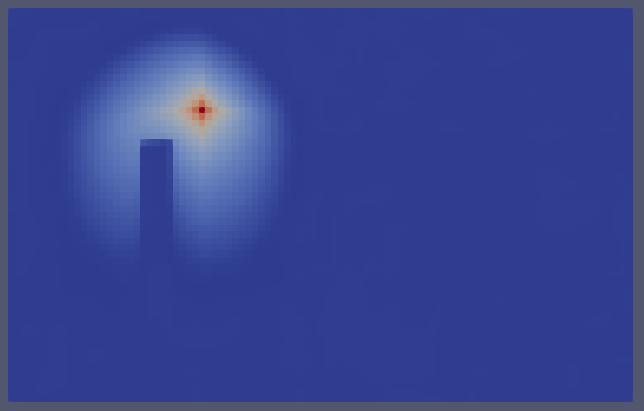
Results
Saturation initializations :
Standard
Hybrid

Slide 25
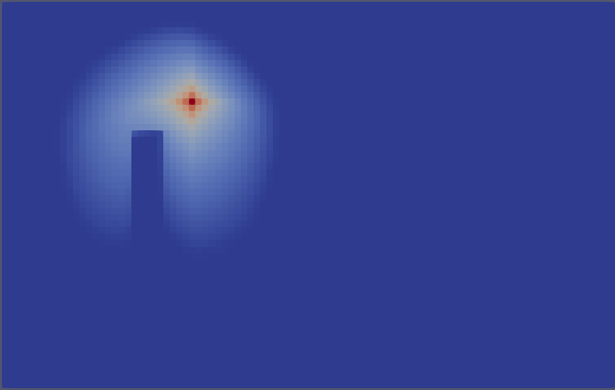
Results
Saturation initializations :
Standard
Solution
Hybrid

Slide 26
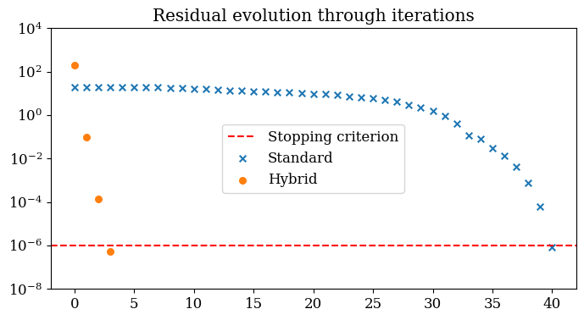
Results
Saturation initializations :
Standard
Solution
Hybrid

Slide 27
Results
 | Acceleration
Test | 39%
Train | 39%

Slide 28
Summary of Global Hybrid Newton
Advantages | Drawbacks
Acceleration of numerical simulation for a large range of well events | Offline phase expensive :
 |  | Data generation Model training
Online phase affordable | Constant well location

Slide 29
Conclusion and perspectives
Integration of Hybrid Newton preconditioning in OPM
Challenges:
More complex physical model
Training data generation cost
Multi-well handling
Heterogeneities
Discretization
Current developments:
Local Hybrid Newton → Reduce training cost / Multi-well handling
Generalized well model → Reduce Dataset generation cost

Slide 30
References
Hybrid Newton
Alban Odot, Ryadh Haferssas, and Stéphane Cotin. Deepphysics: a physics aware deep learning framework for real-time simulation. CoRR, abs/2109.09491, 2021.
Ichrak Ben Yahia, Jean-Pierre Merlet, and Yves Papegay. Mixing neural networks and the Newton method for the kinematics of simple cabledriven parallel robots with sagging cables. In ICAR 2021 - 20th International Conference on advanced robotics, Ljulbjana, Slovenia, December 2021.
Jianguo Huang, Haoqin Wang, and Haizhao Yang. Int-deep: A deep learning initialized iterative method for nonlinear problems. Journal of Computational Physics, 419:109675, 2020.
Subhrajyoti Bhattacharyya and Aditya Vyas. A novel methodology for fast reservoir simulation of single-phase gas reservoirs using machine learning. Heliyon, 8(12):e12067, 2022.
Joubine Aghili, Emmanuel Franck, Romain Hild, Victor Michel-Dansac, Vincent Vigon. Accelerating the convergence of Newton's method for nonlinear elliptic PDEs using Fourier neural operators. 2024. ⟨hal-04440076⟩
Other citations
Bicheng Yan, Bailian Chen, Dylan Robert Harp, Wei Jia, Rajesh J. Pawar, A robust deep learning workflow to predict multiphase flow behavior during geological CO2 sequestration injection and Post-Injection periods, Journal of Hydrology, Volume 607, 2022, 127542, ISSN 0022-1694, https://doi.org/10.1016/j.jhydrol.2022.127542.
Github repository
https://github.com/PINN-Well-opening-and-closing-events/Yads.git

Slide 31
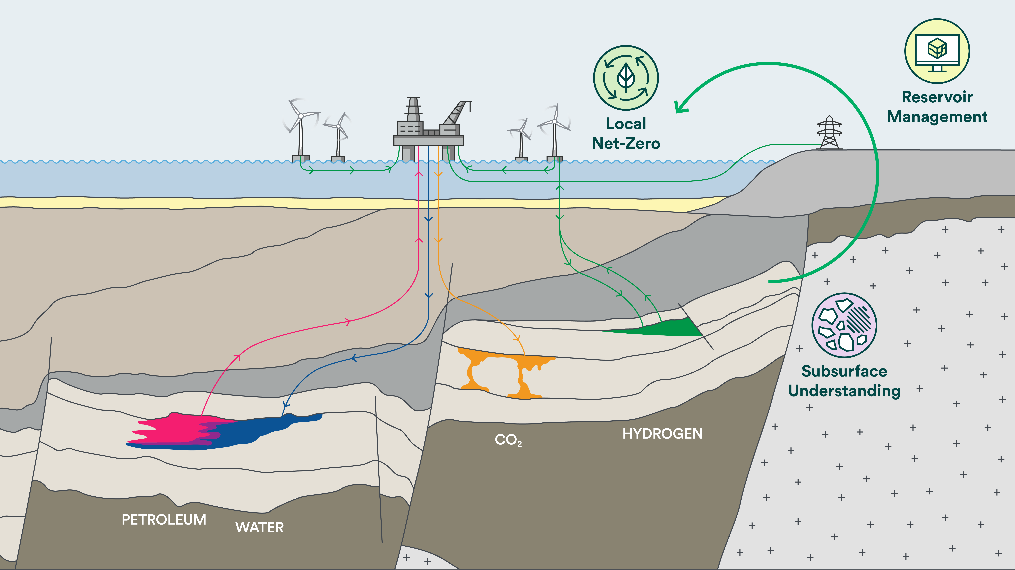
Research for optimal reservoir operations and value generation in the green transition
Strategies to synchronize water injection with intermittent energy
Energy-efficient petroleum production
Scalable solutions for subsurface storage of hydrogen, air, and heat
Energy storage in the subsurface
Flexible solutions for CO₂ storage in depleted reservoirs
CCS: Carbon storage
Digitalization of subsurface management
Update workflows to increase predictive capacity and harness the value of subsurface data
Reservoir physics, geosciences and applied mathematics
Interdisciplinary research and education
Centre Director: Sarah Gasda,
Email: sgas@norceresearch.no
Website: cssr.no
CSSR is a Petrocentre financed by NFR (nr: 331841)
NORCE lead, UiB partner, 170 MNOK budget, start-up 2022.
Supported by major operators and technology providers

Slide 32
CSSR colour palett
Focus Area 1
(WP1 & 2)
Headlines/ text
Headlines/ text
Highlights
Focus Area 2
(WP3, 4& 5)
Focus Area 3 (WP6 & 7)

